Slide 1

Portage APL Project
By Group 12

Slide 2
Big Idea
Increasing fundraising activities through different mediums by which APL can accommodate more animals to the shelter and can provide better care to them

Slide 3
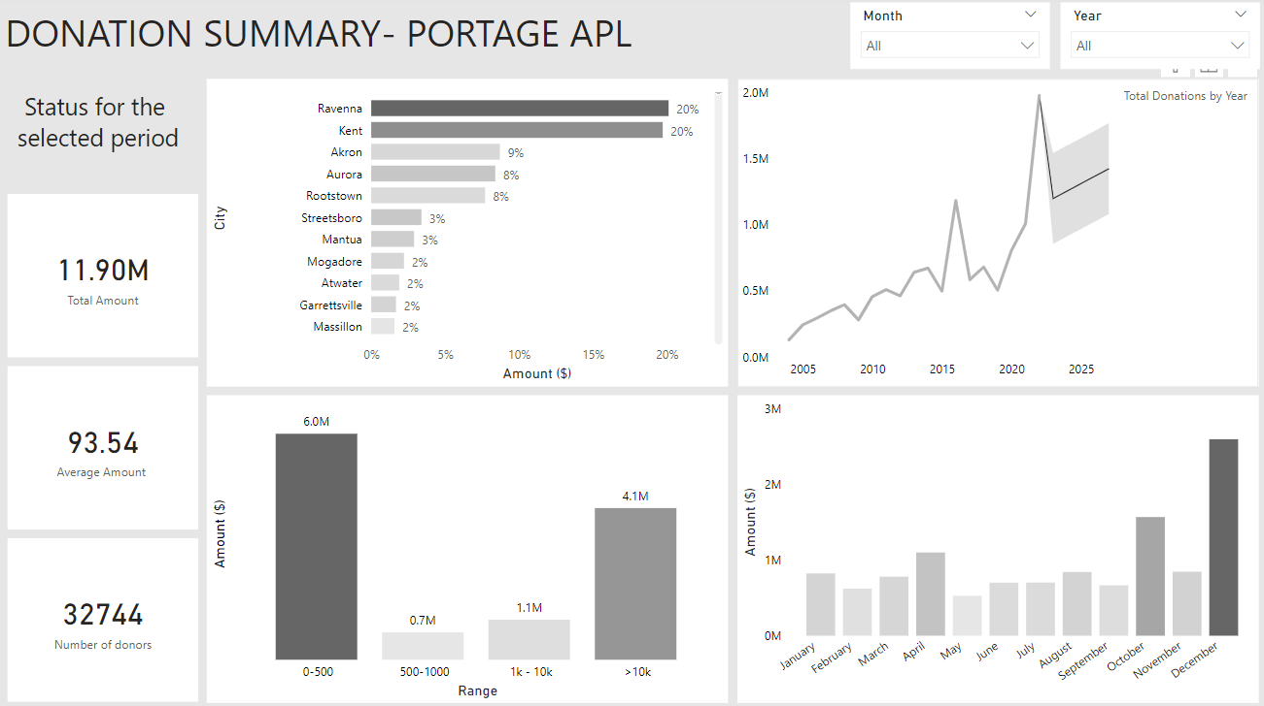
Dashboard

Slide 4

Actions which can be taken from dashboard

Slide 5
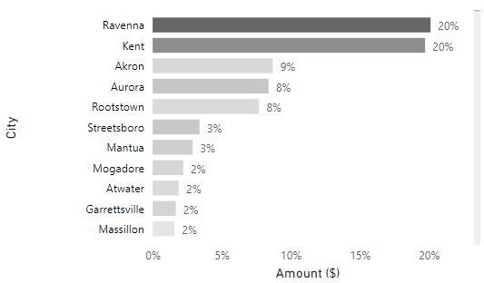
Can decide on which cities to more concentrate for conducting events and promotions

Slide 6
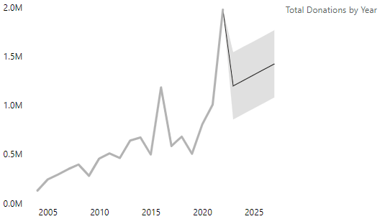
Helps in setting up benchmark for future years and for forecasting, the total amount of donations can be used to set fundraising goals for the organization. By setting realistic goals and tracking progress towards them.

Slide 7
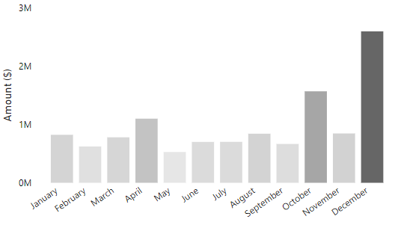
Can decide on which part of the year's events can be conducted more to attract donors

Slide 8
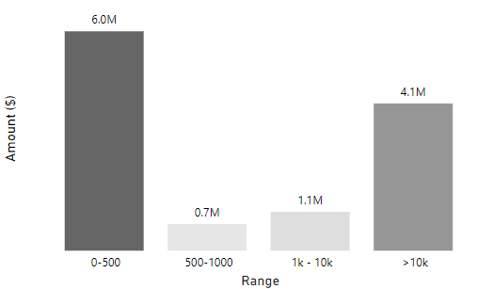
Focus on getting donations in the range of $(0-500), as that is highest bracket.
Can persuade people to do at least small amount of donations rather than asking for big donations.

Slide 9

Thank you !

